Slide 1
Machine Learning Methods in Vulnerable Communities Classification
Checkpoint

Slide 2
Objective
Identify risk communities in a community using machine learning methods
Random Forests
XGBoost
Logistic Regression

Slide 3
Machine Learning
Basic equation: Obj(θ) = L(θ) + Ω(θ)
L – Training Loss
Ω – Regularization
Ex: Linear regression, Logistic Regression, Decision Trees

Slide 4
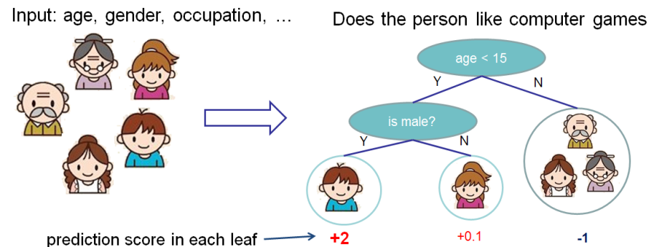
Decision Trees

Slide 5
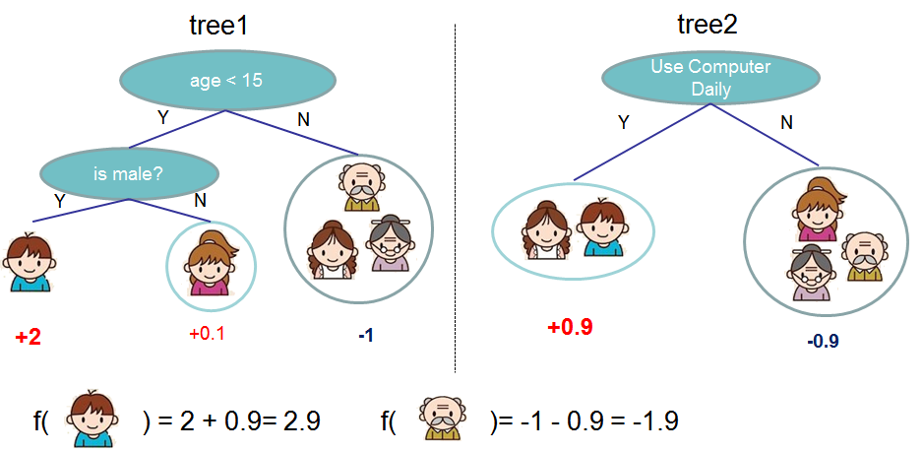
Random Forests

Slide 6
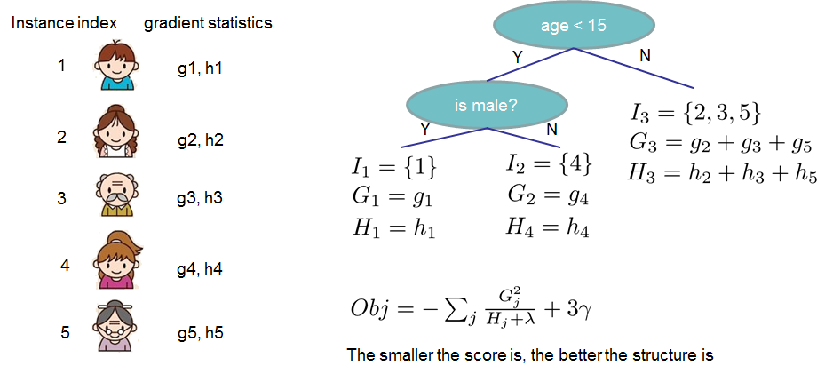
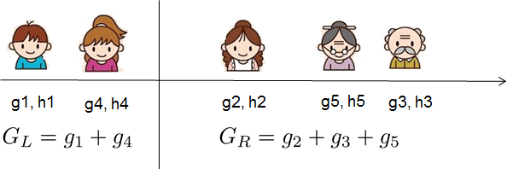
Gradient Boosting (XGBoost)

Slide 7
Kaagle – Give me Some Credit
Seq | Serious Dlqin2yrs | RevolvingUtilization OfUnsecuredLines | age | NumberOfTime30-59 DaysPastDueNotWorse | Debt Ratio | Monthly Income | NumberOfOpen CreditLinesAndLoans | NumberOf Times90DaysLate | NumberRealEstate LoansOrLines | NumberOfTime60-89 DaysPastDueNotWorse | NumberOf Dependents
1 | 1 | 0.766126609 | 45 | 2 | 0.802982129 | 9120 | 13 | 0 | 6 | 0 | 2
2 | 0 | 0.957151019 | 40 | 0 | 0.121876201 | 2600 | 4 | 0 | 0 | 0 | 1
3 | 0 | 0.65818014 | 38 | 1 | 0.085113375 | 3042 | 2 | 1 | 0 | 0 | 0
4 | 0 | 0.233809776 | 30 | 0 | 0.036049682 | 3300 | 5 | 0 | 0 | 0 | 0
5 | 0 | 0.9072394 | 49 | 1 | 0.024925695 | 63588 | 7 | 0 | 1 | 0 | 0
6 | 0 | 0.213178682 | 74 | 0 | 0.375606969 | 3500 | 3 | 0 | 1 | 0 | 1
7 | 0 | 0.305682465 | 57 | 0 | 5710 | NA | 8 | 0 | 3 | 0 | 0
8 | 0 | 0.754463648 | 39 | 0 | 0.209940017 | 3500 | 8 | 0 | 0 | 0 | 0
9 | 0 | 0.116950644 | 27 | 0 | 46 | NA | 2 | 0 | 0 | 0 | NA
10 | 0 | 0.189169052 | 57 | 0 | 0.606290901 | 23684 | 9 | 0 | 4 | 0 | 2
11 | 0 | 0.644225962 | 30 | 0 | 0.30947621 | 2500 | 5 | 0 | 0 | 0 | 0
12 | 0 | 0.01879812 | 51 | 0 | 0.53152876 | 6501 | 7 | 0 | 2 | 0 | 2
13 | 0 | 0.010351857 | 46 | 0 | 0.298354075 | 12454 | 13 | 0 | 2 | 0 | 2
14 | 1 | 0.964672555 | 40 | 3 | 0.382964747 | 13700 | 9 | 3 | 1 | 1 | 2
15 | 0 | 0.019656581 | 76 | 0 | 477 | 0 | 6 | 0 | 1 | 0 | 0
16 | 0 | 0.548458062 | 64 | 0 | 0.209891754 | 11362 | 7 | 0 | 1 | 0 | 2
17 | 0 | 0.061086118 | 78 | 0 | 2058 | NA | 10 | 0 | 2 | 0 | 0
18 | 0 | 0.166284079 | 53 | 0 | 0.18827406 | 8800 | 7 | 0 | 0 | 0 | 0
19 | 0 | 0.221812771 | 43 | 0 | 0.527887839 | 3280 | 7 | 0 | 1 | 0 | 2
20 | 0 | 0.602794411 | 25 | 0 | 0.065868263 | 333 | 2 | 0 | 0 | 0 | 0
21 | 0 | 0.200923382 | 43 | 0 | 0.430046338 | 12300 | 10 | 0 | 2 | 0 | 0
22 | 1 | 0.025655677 | 38 | 0 | 0.475841386 | 3000 | 7 | 0 | 1 | 0 | 2
23 | 0 | 0.9999999 | 39 | 0 | 0.241103559 | 2500 | 4 | 0 | 0 | 0 | 0
24 | 0 | 0.075426584 | 32 | 0 | 0.085512189 | 7916 | 6 | 0 | 0 | 0 | 0
25 | 0 | 0.04656027 | 58 | 0 | 0.241621845 | 2416 | 9 | 0 | 1 | 0 | 0
26 | 1 | 0.392248482 | 50 | 0 | 1.595.253.368 | 4676 | 14 | 0 | 3 | 0 | 1

Slide 8
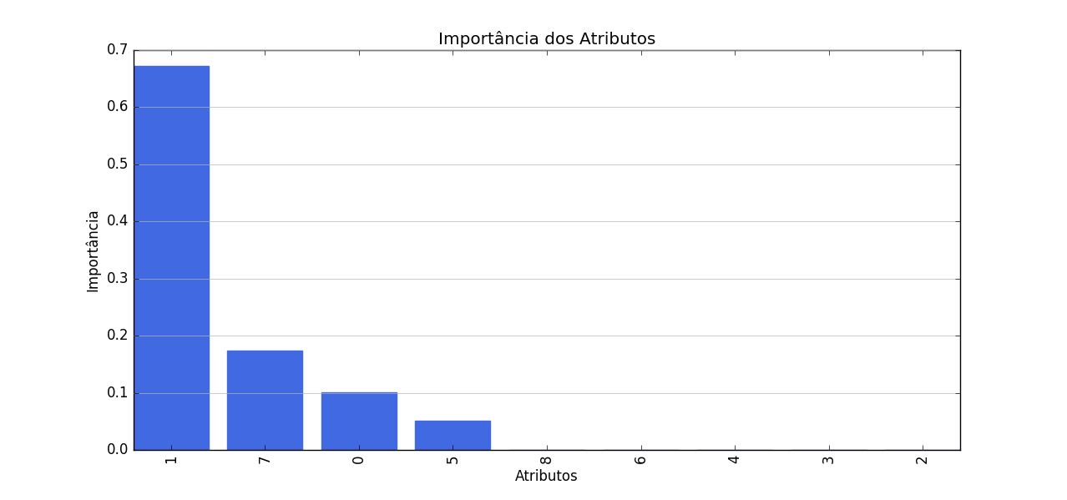
Feature Importance
Id | Feature
1 | NumberOfTime30-59DaysPastDueNotWorse
7 | NumberOfTime60-89DaysPastDueNotWorse
0 | age
5 | NumberOfTimes90DaysLate
8 | NumberOfDependents
6 | NumberRealEstateLoansOrLines
4 | NumberOfOpenCreditLinesAndLoans
3 | MonthlyIncome
2 | DebtRatio

Slide 9
Feature Comparison
SeriousDlqin2yrs NumberOfTime30-59DaysPastDueNotWorse NumberOfTime60-89DaysPastDueNotWorse
count 139974.0 139974.000000 139974.000000
mean 0.0 0.280109 0.126666
std 0.0 2.946075 2.900930
min 0.0 0.000000 0.000000
25% 0.0 0.000000 0.000000
50% 0.0 0.000000 0.000000
75% 0.0 0.000000 0.000000
max 0.0 98.000000 98.000000
SeriousDlqin2yrs NumberOfTime30-59DaysPastDueNotWorse NumberOfTime60-89DaysPastDueNotWorse
count 10026.0 10026.00000 10026.000000
mean 1.0 2.38849 1.828047
std 0.0 11.73451 11.753068
min 1.0 0.00000 0.000000
25% 1.0 0.00000 0.000000
50% 1.0 0.00000 0.000000
75% 1.0 2.00000 1.000000
max 1.0 98.00000 98.000000

Slide 10
POC – Decision Trees
Try and tune various models for DecisionTreeClassifier
Model: DecisionTreeClassifier for: ['age', 'NumberOfTime30-59DaysPastDueNotWorse', 'DebtRatio', 'MonthlyIncome', 'NumberOfOpenCreditLinesAndLoans', 'NumberOfTimes90DaysLate', 'NumberRealEstateLoansOrLines', 'NumberOfTime60-89DaysPastDueNotWorse', 'NumberOfDependents']
Cross-Validation Score : 93.5347%
{'splitter': 'random', 'max_leaf_nodes': 10, 'min_samples_leaf': 14, 'min_samples_split': 50, 'random_state': 3, 'criterion': 'entropy', 'max_features': None, 'max_depth': 5}
Cross-Validation Score : 93.5353%
{'splitter': 'random', 'max_leaf_nodes': 10, 'min_samples_leaf': 14, 'min_samples_split': 50, 'random_state': 3, 'criterion': 'entropy', 'max_features': None, 'max_depth': 4}
Cross-Validation Score : 93.5353%
{'splitter': 'random', 'max_leaf_nodes': 10, 'min_samples_leaf': 14, 'min_samples_split': 50, 'random_state': 3, 'criterion': 'entropy', 'max_features': None, 'max_depth': 3}
DecisionTreeClassifier(class_weight=None, criterion='entropy', max_depth=3,
max_features=None, max_leaf_nodes=10, min_impurity_split=1e-07,
min_samples_leaf=14, min_samples_split=50,
min_weight_fraction_leaf=0.0, presort=False, random_state=3,
splitter='random')
Accuracy : 93.5433%

Slide 11
POC – Random Forests
Try and tune various models for RandomForestClassifier
Model: RandomForestClassifier for: ['age', 'NumberOfTime30-59DaysPastDueNotWorse', 'DebtRatio', 'MonthlyIncome', 'NumberOfOpenCreditLinesAndLoans', 'NumberOfTimes90DaysLate', 'NumberRealEstateLoansOrLines', 'NumberOfTime60-89DaysPastDueNotWorse', 'NumberOfDependents']
Cross-Validation Score : 93.6307%
{'n_jobs': 1, 'max_leaf_nodes': 30, 'min_samples_leaf': 10, 'n_estimators': 60, 'max_features': 'auto', 'random_state': None, 'criterion': 'gini', 'min_samples_split': 15, 'max_depth': 8}
Cross-Validation Score : 93.6447%
{'n_jobs': 1, 'max_leaf_nodes': 30, 'min_samples_leaf': 10, 'n_estimators': 60, 'max_features': 'auto', 'random_state': None, 'criterion': 'gini', 'min_samples_split': 5, 'max_depth': 8}
RandomForestClassifier(bootstrap=True, class_weight=None, criterion='gini',
max_depth=8, max_features='auto', max_leaf_nodes=30,
min_impurity_split=1e-07, min_samples_leaf=10,
min_samples_split=5, min_weight_fraction_leaf=0.0,
n_estimators=60, n_jobs=1, oob_score=False, random_state=None,
verbose=0, warm_start=False)
Accuracy : 93.6987%

Slide 12
POC – Logistic Regression
Try and tune various models for LogisticRegression
Model: LogisticRegression for: ['age', 'NumberOfTime30-59DaysPastDueNotWorse', 'DebtRatio', 'MonthlyIncome', 'NumberOfOpenCreditLinesAndLoans', 'NumberOfTimes90DaysLate', 'NumberRealEstateLoansOrLines', 'NumberOfTime60-89DaysPastDueNotWorse', 'NumberOfDependents']
{'warm_start': False, 'C': 0.1, 'n_jobs': 1, 'verbose': 0, 'intercept_scaling': 1, 'fit_intercept': True, 'max_iter': 300, 'penalty': 'l2', 'multi_class': 'ovr', 'random_state': None, 'dual': False, 'tol': 0.0001, 'solver': 'newton-cg', 'class_weight': None} 93.3867 0.0
Cross-Validation Score : 93.3867%
{'warm_start': False, 'C': 0.1, 'n_jobs': 1, 'verbose': 0, 'intercept_scaling': 1, 'fit_intercept': True, 'max_iter': 300, 'penalty': 'l2', 'multi_class': 'ovr', 'random_state': None, 'dual': False, 'tol': 0.0001, 'solver': 'newton-cg', 'class_weight': None}
... skipped
{'warm_start': False, 'C': 0.5, 'n_jobs': 1, 'verbose': 0, 'intercept_scaling': 1, 'fit_intercept': True, 'max_iter': 300, 'penalty': 'l2', 'multi_class': 'ovr', 'random_state': None, 'dual': False, 'tol': 0.0001, 'solver': 'newton-cg', 'class_weight': None} 93.388 93.3867
Cross-Validation Score : 93.3880%
{'warm_start': False, 'C': 0.5, 'n_jobs': 1, 'verbose': 0, 'intercept_scaling': 1, 'fit_intercept': True, 'max_iter': 300, 'penalty': 'l2', 'multi_class': 'ovr', 'random_state': None, 'dual': False, 'tol': 0.0001, 'solver': 'newton-cg', 'class_weight': None}
... skipped
{'warm_start': False, 'C': 1.0, 'n_jobs': 1, 'verbose': 0, 'intercept_scaling': 1, 'fit_intercept': True, 'max_iter': 100, 'penalty': 'l2', 'multi_class': 'ovr', 'random_state': None, 'dual': False, 'tol': 0.0001, 'solver': 'sag', 'class_weight': None} 93.316 93.388
LogisticRegression(C=1.0, class_weight=None, dual=False, fit_intercept=True,
intercept_scaling=1, max_iter=100, multi_class='ovr', n_jobs=1,
penalty='l2', random_state=None, solver='newton-cg', tol=0.0001,
verbose=0, warm_start=False)
Accuracy : 93.3887%

Slide 13
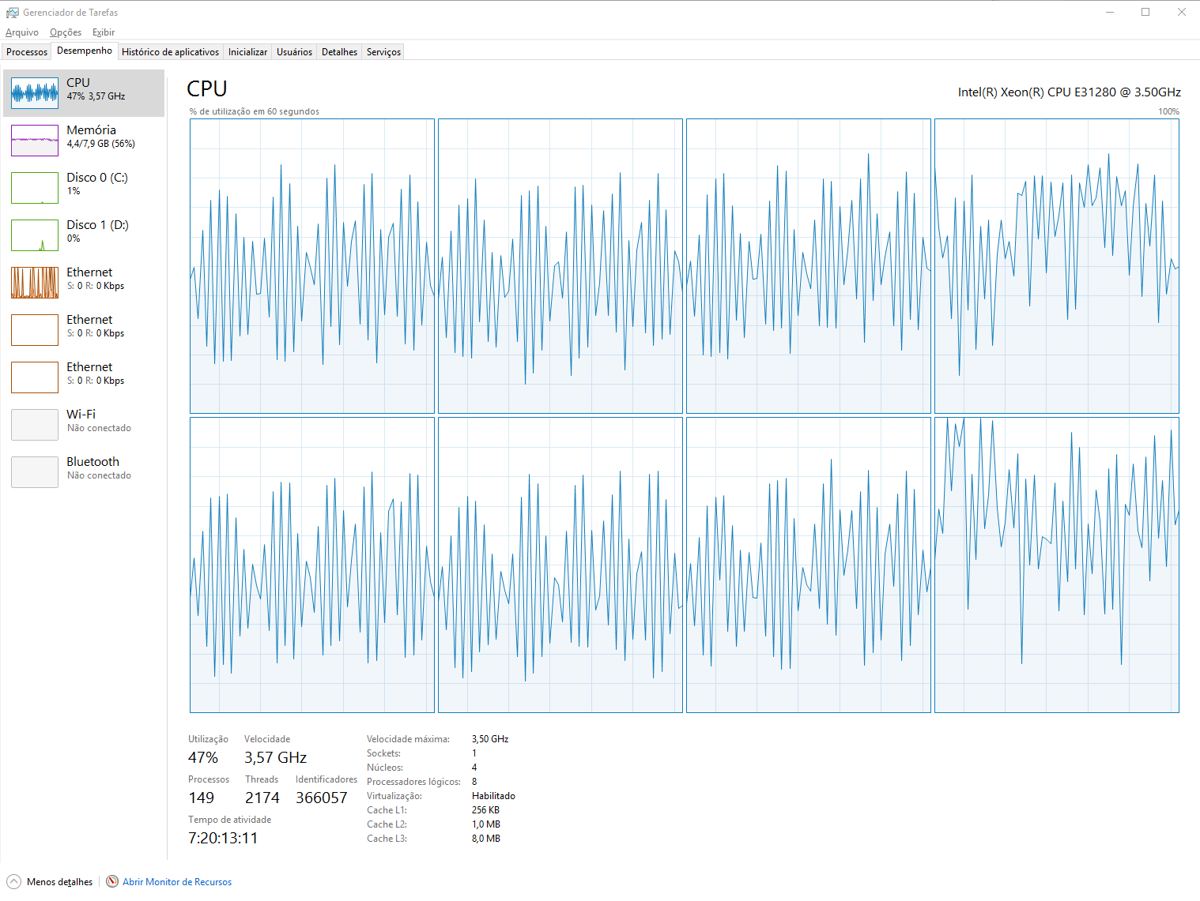
XGBoost – 5.000 linhas em R - CPU

Slide 14
XGBoost
Features: SeriousDlqin2yrs, NumberOfTime30.59DaysPastDueNotWorse, NumberOfTime60.89DaysPastDueNotWorse, NumberOfTimes90DaysLate, age)
Parameters: max.depth=2, nround=7000, objective = "reg:linear", verbose=0, eta=0.001, min_child_weight=1, gamma=0, subsample=0.1, colsample_bytree=0.5, missing=NaN
Accuracy : 93.7107%

Slide 15
QUESTIONS?

